Slide 1

Revocable Policy-Based Chameleon Hash
西安邮电大学
XI'AN UNIVERSITY OF POSTS
& TELECOMMUNICATIONS
($XU Shengmin; NING Jianting; MA Jinhua; XU Guowen$;)
（European Symposium on Research in Computer Security）
（ESORICS 2021）
汇报人：李佳薇

Slide 2
西安邮电大学
XI'AN UNIVERSITY OF POSTS
& TELECOMMUNICATIONS
Introduction
背景：
在实践中，变色龙陷门持有者可能会滥用重写特权，恶意重写哈希对象（例如，可变区块链中的事务内容和可净化签名中的消息）来传播不正确的内容，甚至出售重写特权以获得非法利润。这种被滥用的特权必须被撤销，然而，目前的基于策略的变色龙哈希PCH提案[16,34]没有提供重写特权的可撤销性。
改进：
使用可撤销的ABE(RABE)来实现具有可撤销性的PCH[16,34]——RPCH。
CP-ABE+CHET
[16]Derler, D., Samelin, K., Slamanig, D., Striecks, C.: Fine-grained and controlled rewriting in blockchains: Chameleon-hashing gone attribute-based. In: NDSS (2019)
[34]Samelin, K., Slamanig, D.: Policy-based sanitizable signatures. In: Jarecki, S. (ed.) CT-RSA 2020. LNCS, vol. 12006, pp. 538–563. Springer, Cham (2020).

Slide 3
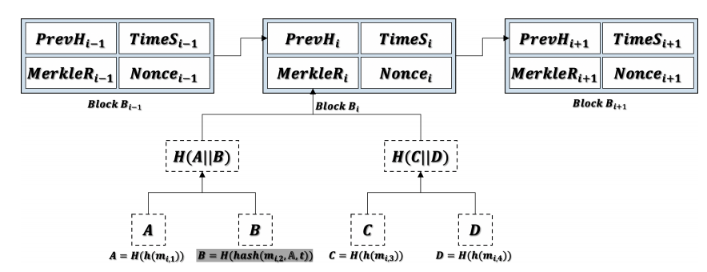









西安邮电大学
XI'AN UNIVERSITY OF POSTS
& TELECOMMUNICATIONS
Mutable Blockchain
可变区块链
区块链：不可篡改性，交易内容映射到Merkle根，如果在本地篡改交易，则其他节点不会予以认可；
实际场景中可能出现如交易内容或区块里包含隐私信息需要撤销等需求。
可变区块链：利用变色龙哈希Chameleon Hash代替现有的Hash结构，修改事务内容而不改变根节点值。
$$B=H(h({sk}_{s_{1}},{m′}_{i,2},A,t))$$
$$B=H(h({sk}_{s_{2}},{m′}_{i,2},A,t))$$
$$s_{1}$$
$$s_{2}$$
$$B=H(h({sk}_{s_{3}},{m′}_{i,2},A,t))$$
$$s_{3}$$
$$B=H(h(m_{i,2}))$$
$$B=H(h(m_{i,2},A,t))$$
Derler, D., Samelin, K., Slamanig, D., Striecks, C.: Fine-grained and controlled rewriting in blockchains: Chameleon-hashing gone attribute-based. In: NDSS (2019)

Slide 4









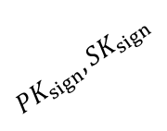
西安邮电大学
XI'AN UNIVERSITY OF POSTS
& TELECOMMUNICATIONS
Sanitizable Signature
Sanitizable Signature(可净化签名)
签名者以可控的方式可将签名权限授权给净化者，净化者还可对签名者所提供的消息进行修改，未修改部分的完整新和真实性仍然是可验证的。特别地，对于不允许修改的部分，净化者不能对其修改，也无法对这种非法的修改提供有效的签名。
数据及签名
$${PK}_{sign},{SK}_{sign}$$
签名者
数据、签名、允许修改的信息
数据及签名
KGC
$${{PK}_{sani},SK}_{sani}$$
云服务器
用户
净化后的数据及签名
净化者
[34]Samelin, K., Slamanig, D.: Policy-based sanitizable signatures. In: Jarecki, S. (ed.) CT-RSA 2020. LNCS, vol. 12006, pp. 538–563. Springer, Cham (2020).

Slide 5
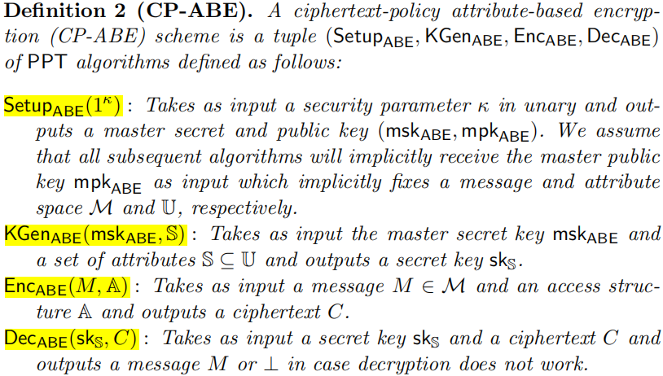




西安邮电大学
XI'AN UNIVERSITY OF POSTS
& TELECOMMUNICATIONS
ciphertext-policy attribute-based encryption (CP-ABE)
PCH construction is based on CP-ABE scheme and a chameleon-hash with ephemeral trapdoors (CHET)
KGC
S
(msk,mpk)
(${\text{sk}}_{S}$)
消息M
密文C
属性集S
数据拥有者
用户1
访问控制结构A
(${\text{sk}}_{S}$)
消息M
Derler, D., Samelin, K., Slamanig, D., Striecks, C.: Fine-grained and controlled rewriting in blockchains: Chameleon-hashing gone attribute-based. In: NDSS (2019)

Slide 6
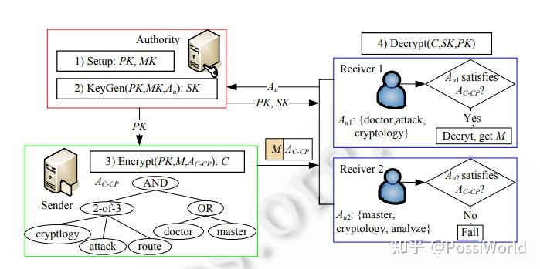
西安邮电大学
XI'AN UNIVERSITY OF POSTS
& TELECOMMUNICATIONS
ciphertext-policy attribute-based encryption (CP-ABE)
CP-ABE （密文策略 ABE）
CP-ABE由于策略嵌入密文中，数据拥有者可以通过设定策略去决定拥有哪些属性的人能够访问这份密文，相当于对这份数据做了一个加密访问控制。CP-ABE 的应用场景为公有云上的数据加密存储与共享。

Slide 7
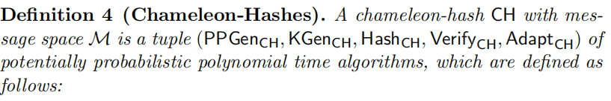
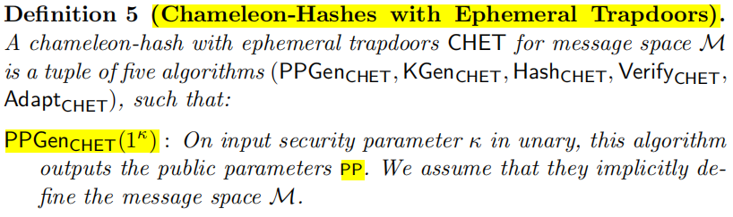
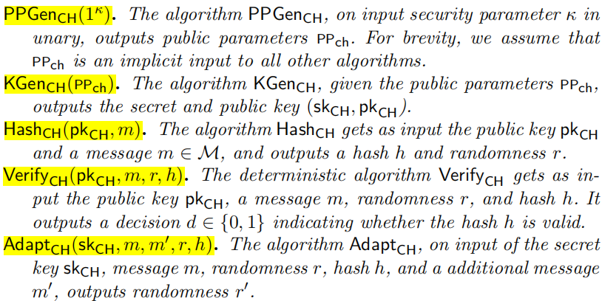
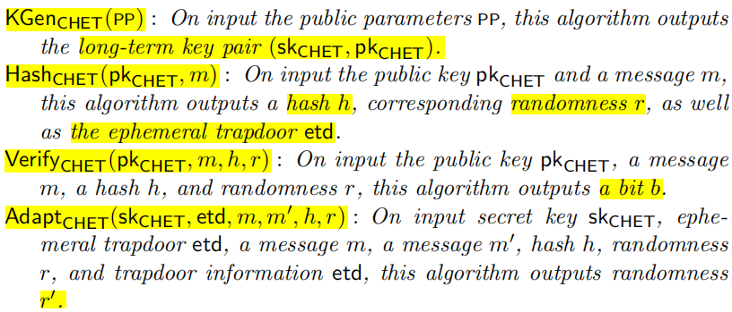
西安邮电大学
XI'AN UNIVERSITY OF POSTS
& TELECOMMUNICATIONS
Chameleon Hashs
PCH construction is based on CP-ABE scheme and a chameleon-hash with ephemeral trapdoors (CHET)
拥有暂时陷门和长期密钥的人才能够计算哈希碰撞
Derler, D., Samelin, K., Slamanig, D., Striecks, C.: Fine-grained and controlled rewriting in blockchains: Chameleon-hashing gone attribute-based. In: NDSS (2019)
Camenisch, J., Derler, D., Krenn, S., P¨ohls, H.C., Samelin, K., Slamanig, D.: Chameleon-hashes with ephemeral trapdoors. In: Fehr, S. (ed.) PKC 2017. LNCS, vol. 10175, pp. 152–182. Springer, Heidelberg (2017).

Slide 8
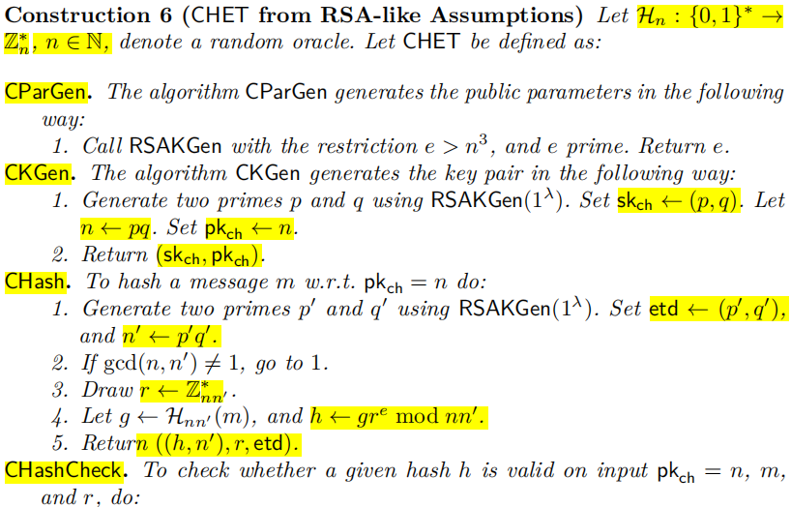
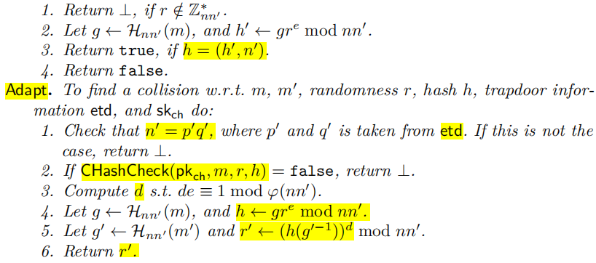
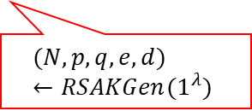
西安邮电大学
XI'AN UNIVERSITY OF POSTS
& TELECOMMUNICATIONS
Chameleon Hash with ephemeral trapdoors(CHET)
$$(N,p,q,e,d)←RSAKGen(1^{λ})$$
Camenisch, J., Derler, D., Krenn, S., P¨ohls, H.C., Samelin, K., Slamanig, D.: Chameleon-hashes with ephemeral trapdoors. In: Fehr, S. (ed.) PKC 2017. LNCS, vol. 10175, pp. 152–182. Springer, Heidelberg (2017).

Slide 9
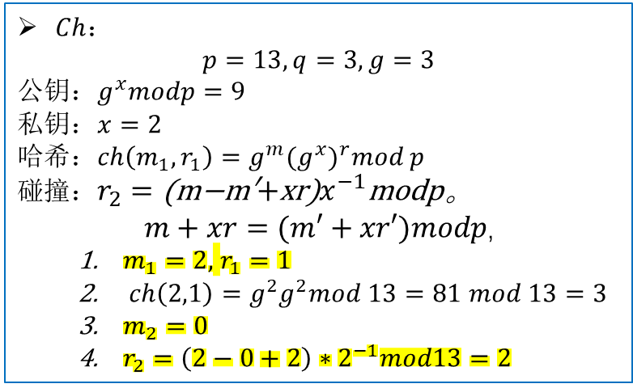

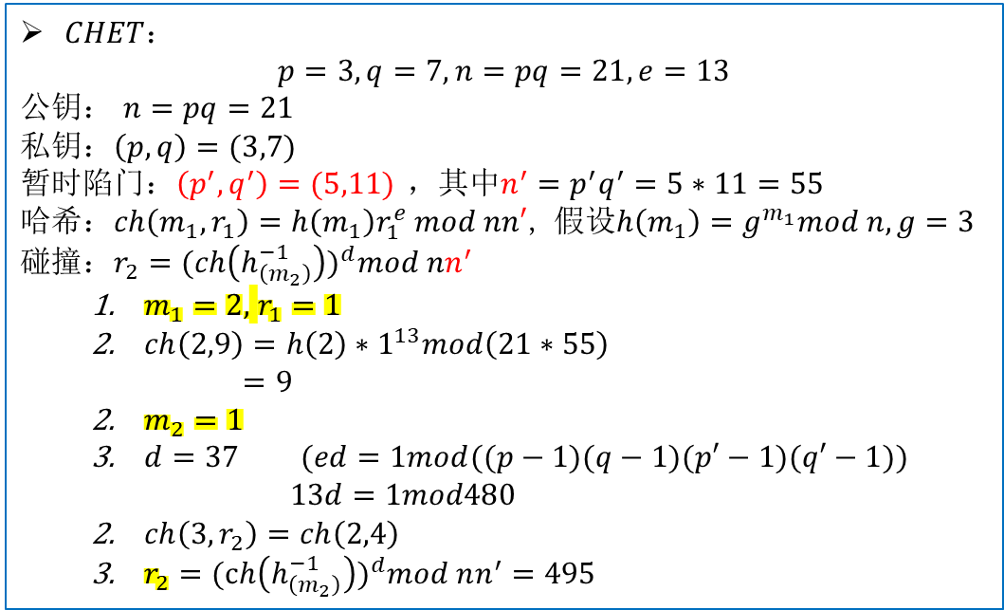
西安邮电大学
XI'AN UNIVERSITY OF POSTS
& TELECOMMUNICATIONS
Ch and CHET
$$example：$$
$Ch$：
$$p=13,q=3,g=3$$
公钥$：g^{x}modp=9$
私钥：$x=2$
哈希：$ch\left(m_{1}, r_{1}\right)=g^{m}({g^{x})}^{r}mod p$
碰撞：$r_{2}=\text{(}\text{m}\text{−}\text{m}\text{′}\text{+}\text{xr}\text{)}x^{−1}\text{modp}\text{。}$
$$m+xr=(m′+xr′)modp\text{,}$$
$m_{1}=2,$ $r_{1}=1$
$ch\left(2,1\right)=g^{2}g^{2}mod 13=81 mod 13=3$
$m_{2}=0$
$r_{2}=\left(2−0+2\right)∗2^{−1}mod13=2$
$CHET$：
$$p=3,q=7,n=pq=21,e=13$$
公钥$：$ $n=pq=21$
私钥：$\left(p,q\right)=(3,7)$
暂时陷门：$\left(p^{′},q^{′}\right)=(5,11)$ ，其中$n^{′}=p^{′}q^{′}=5∗11=55$
哈希：$ch\left(m_{1}, r_{1}\right)=h\left(m_{1}\right)r_{1}^{e} mod nn′$, 假设$h\left(m_{1}\right)=g^{m_{1}}mod n,g=3$
碰撞：$r_{2}={(ch\left(h_{\left(m_{2}\right)}^{−1}\right))}^{d}mod nn^{′}$
$m_{1}=2,$ $r_{1}=1$
$ch\left(2,9\right)=h\left(2\right)∗1^{13}mod\left(21∗55\right)$
$=9$
$m_{2}=1$
$d=37$ $(ed=1mod((p−1)(q−1)(p′−1)(q′−1))$
$13d=1mod480$
$ch\left(3,r_{2}\right)=ch\left(2,4\right)$
$r_{2}={(ch\left(h_{\left(m_{2}\right)}^{−1}\right))}^{d}mod nn^{′}=495$

Slide 10
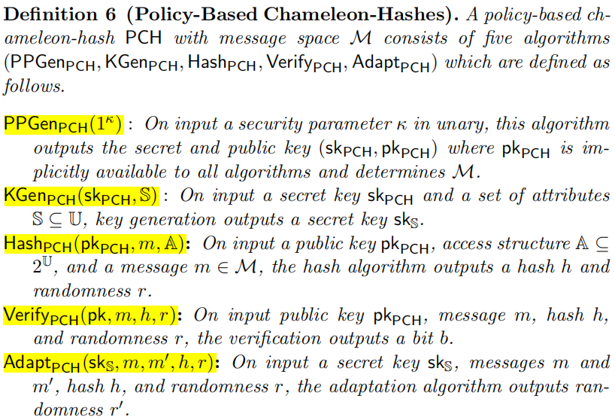







西安邮电大学
XI'AN UNIVERSITY OF POSTS
& TELECOMMUNICATIONS
Revocable Policy-Based Chameleon Hash
PCH construction
属性集U
KGC
$$(sk,pk)$$
(${\text{sk}}_{S}$)
消息$m$
属性集S
$$(h,r)$$
数据拥有者
拥有变色龙陷门的人
访问控制结构A
(${\text{sk}}_{S}$)
($h,r’$)
消息$m’$
Derler, D., Samelin, K., Slamanig, D., Striecks, C.: Fine-grained and controlled rewriting in blockchains: Chameleon-hashing gone attribute-based. In: NDSS (2019)

Slide 11
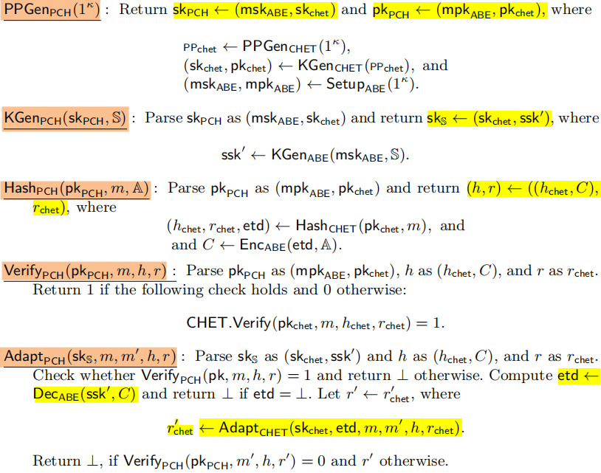








西安邮电大学
XI'AN UNIVERSITY OF POSTS
& TELECOMMUNICATIONS
Revocable Policy-Based Chameleon Hash
PCH with ephemeral trapdoors (CHET)
KGC
$$(sk←(msk,{sk}_{chet}),$$
$$pk←(mpk,{pk}_{chet}))$$
(${\text{sk}}_{S}←({sk}_{chet},ssk′)$)
消息$m$
属性集S
$$(h,r)←(\left(h,C\right),r)$$
数据拥有者
密文$C←Enc(etd,A)$
拥有变色龙私钥和暂时陷门的人
访问控制结构A
(${\text{sk}}_{S}$)
($h,r’$)
消息$m’$
Derler, D., Samelin, K., Slamanig, D., Striecks, C.: Fine-grained and controlled rewriting in blockchains: Chameleon-hashing gone attribute-based. In: NDSS (2019)

Slide 12
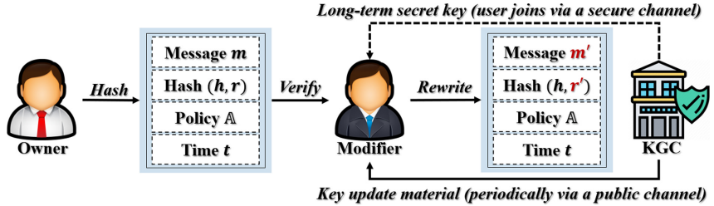
西安邮电大学
XI'AN UNIVERSITY OF POSTS
& TELECOMMUNICATIONS
RPCH Introduction
RPCH系统模型概述：
RPCH允许数据所有者计算与访问策略和时间戳关联的变色龙哈希。另一方被称为变色龙陷门持有人或修改者，谁拥有特权和有效的密钥更新材料，满足访问策略和给定哈希中的时间戳，然后可以找到任意冲突。因此，RPCH支持在细粒度级别上的可修改性和修改者重写特权的可撤销性。
RPCH技术概述：
PRCH遵循了之前的PCH解决方案[16,34]，用RABE取代了底层的ABE方案，并与CHET相结合。在RABE中，当修改者加入时，公布一个基于属性的长期密钥，并在每个周期内公开分发一个密钥更新材料。在CHET中，两个陷门保证重写的安全性：一个长期的陷门和一个暂时的陷门。
[16]Derler, D., Samelin, K., Slamanig, D., Striecks, C.: Fine-grained and controlled rewriting in blockchains: Chameleon-hashing gone attribute-based. In: NDSS (2019)
[34]Samelin, K., Slamanig, D.: Policy-based sanitizable signatures. In: Jarecki, S. (ed.) CT-RSA 2020. LNCS, vol. 12006, pp. 538–563. Springer, Cham (2020).

Slide 13

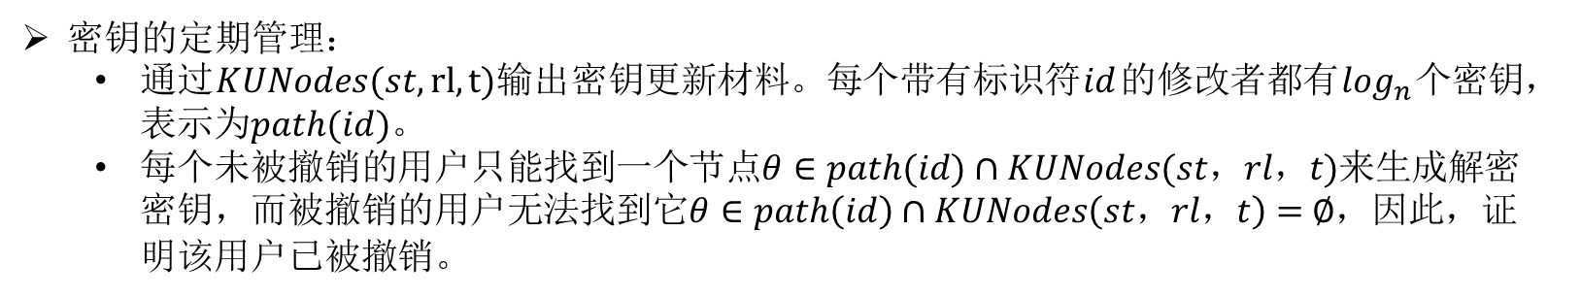
西安邮电大学
XI'AN UNIVERSITY OF POSTS
& TELECOMMUNICATIONS
Introduction
改进：
密钥结构：
在每个周期时间的开始，发布密钥更新材料(包含带有额外的基于时间限制的$g_{θ}$：删除一个随机元素$g_{θ}$管理用户撤销)。
未被撤销的用户可以通过密钥更新材料和基于属性的长期密钥，获得具有基于时间限制的解密密钥，如果时间限制与密文关联的时间戳相匹配，则此密钥可用于解密。
密钥的定期管理：
通过$KUNodes(st,rl,t)输出$密钥更新材料。每个带有标识符$id$的修改者都有$\log_{n}$个密钥，表示为$path(id)$。
每个未被撤销的用户只能找到一个节点$θ∈path(id)∩KUNodes(st，rl，t)$来生成解密密钥，而被撤销的用户无法找到它$θ∈path\left(id\right)∩KUNodes\left(st，rl，t\right)=$ $∅$，因此，证明该用户已被撤销。

Slide 14
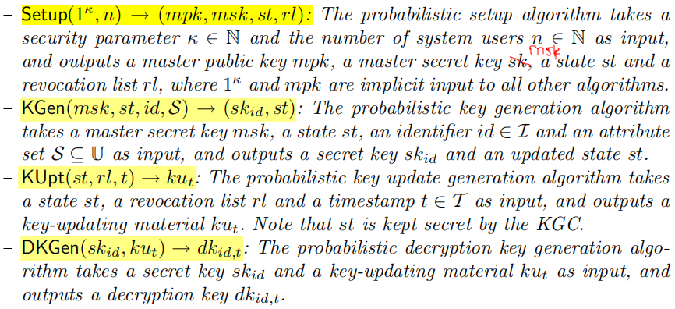
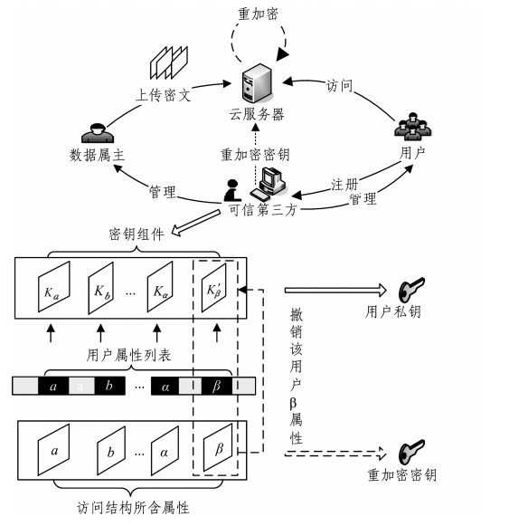
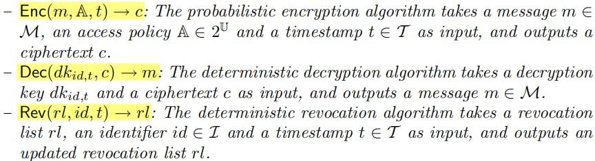

西安邮电大学
XI'AN UNIVERSITY OF POSTS
& TELECOMMUNICATIONS
RABE
Revocable Attribute-Based Encryption
密钥更新材料
KGC
密钥更新材料

Slide 15
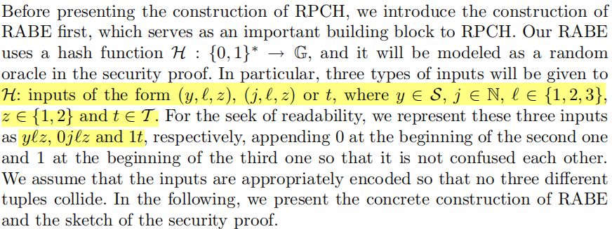
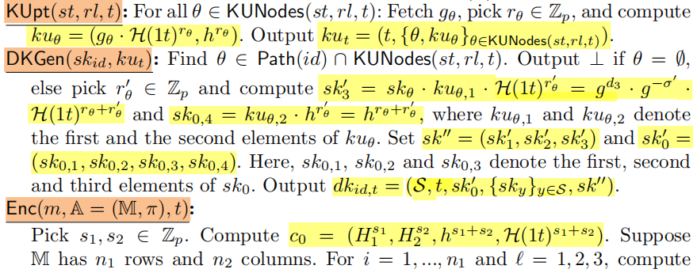
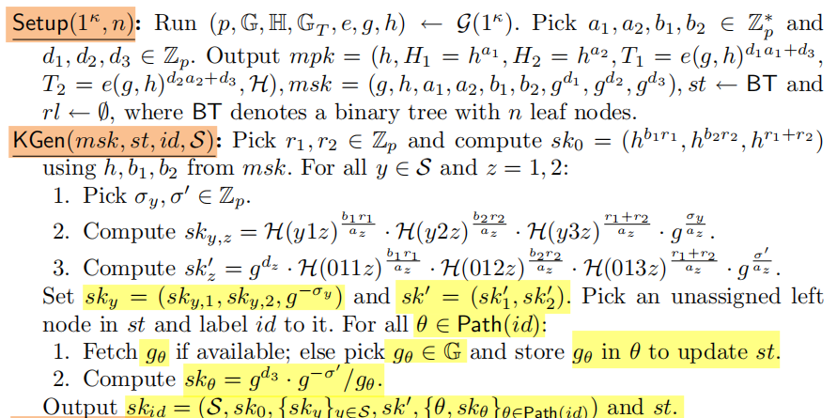
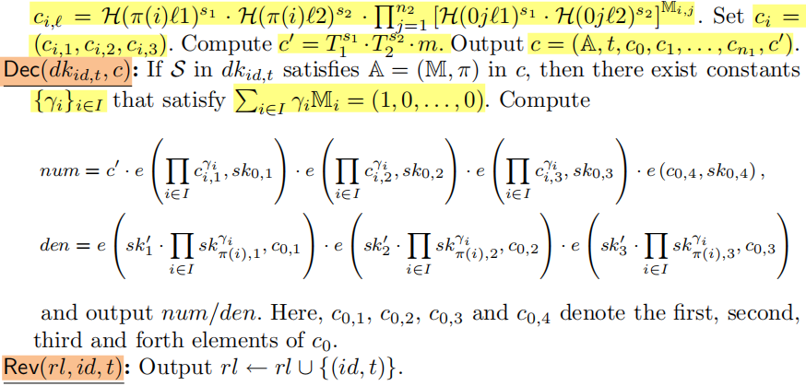
西安邮电大学
XI'AN UNIVERSITY OF POSTS
& TELECOMMUNICATIONS
RABE

Slide 16
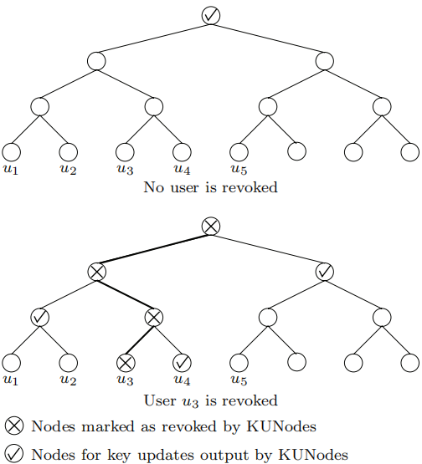
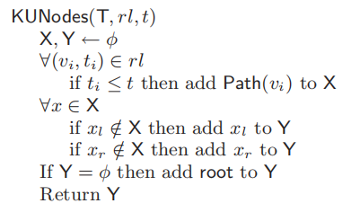



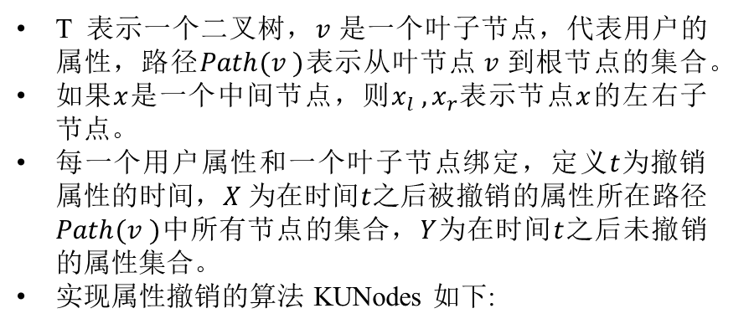













西安邮电大学
XI'AN UNIVERSITY OF POSTS
& TELECOMMUNICATIONS
Tree-Based Structure for User Revocation
Tree-Based Structure for User Revocation
T 表示一个二叉树，$v$是一个叶子节点，代表用户的属性，路径$Path(v )$表示从叶节点$v$到根节点的集合。
如果$x$是一个中间节点，则$x_{l} ,x_{r}$表示节点$x$的左右子节点。
每一个用户属性和一个叶子节点绑定，定义$t$为撤销属性的时间，$X$为在时间$t$之后被撤销的属性所在路径$Path(v )$中所有节点的集合，$Y$为在时间$t$之后未撤销的属性集合。
实现属性撤销的算法 KUNodes 如下:
$$v_{1}$$
$$v_{2}$$
$$v_{3}$$
$$v_{4}$$
$$v_{5}$$
$$v_{6}$$
$$v_{7}$$
$$v_{8}$$
$$v_{1}$$
$$v_{2}$$
$$v_{3}$$
$$v_{4}$$
$$v_{5}$$
$$v_{6}$$
$$v_{7}$$
$$v_{8}$$
Boldyreva, A., Goyal, V., Kumar, V.: Identity-based encryption with effiffifficient revocation. In: CCS, pp. 417–426 (2008)

Slide 17
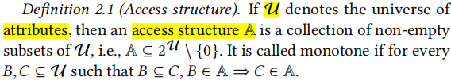
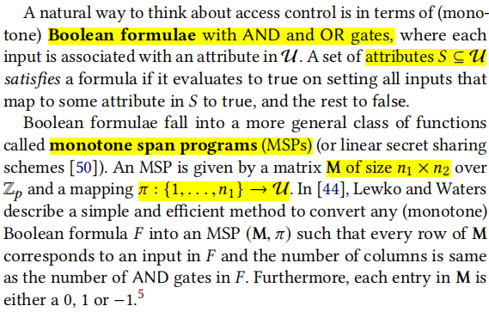
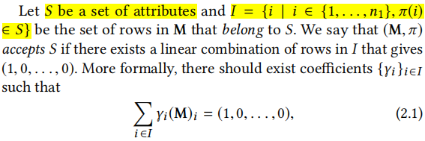
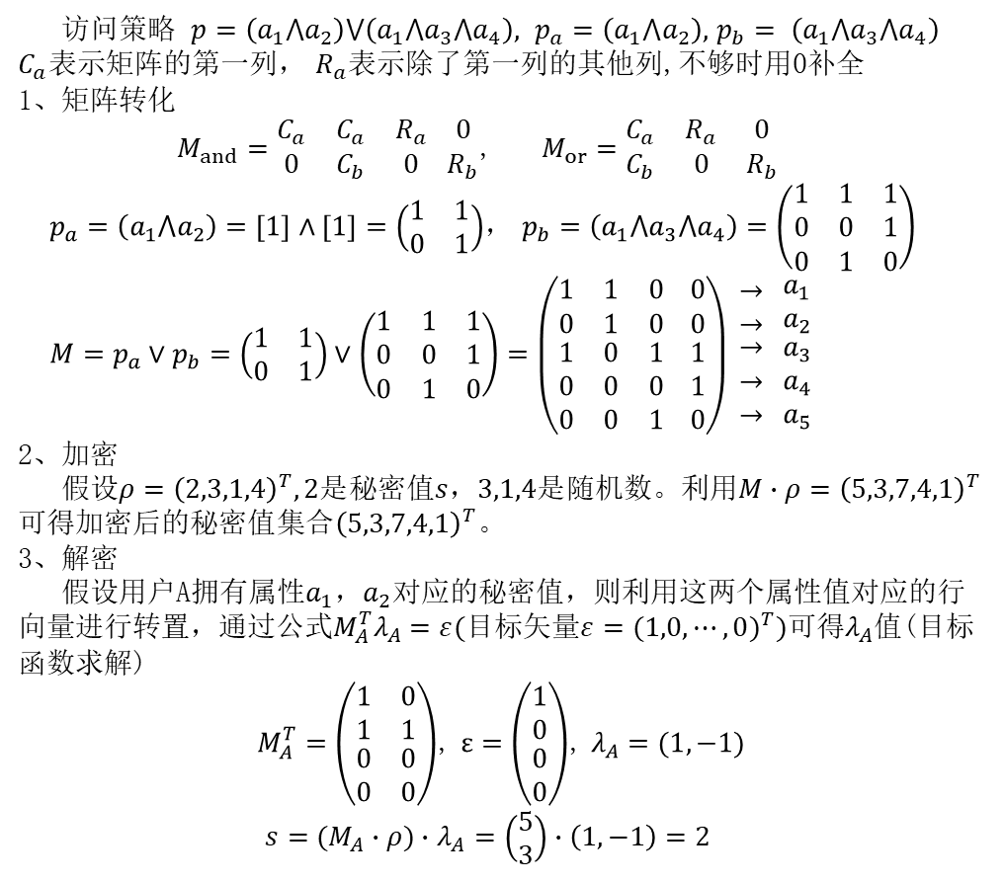
西安邮电大学
XI'AN UNIVERSITY OF POSTS
& TELECOMMUNICATIONS
Access structures
线性秘密分享方案（Linear Secret Sharing Scheme，LSSS）
访问策略 $p=\left(a_{1}⋀a_{2}\right)⋁\left(a_{1}⋀a_{3}⋀a_{4}\right),$ $p_{a}=\left(a_{1}⋀a_{2}\right),$ $p_{b}= \left(a_{1}⋀a_{3}⋀a_{4}\right)$
$C_{a}表示矩阵$的第一列， $R_{a}$表示除了第一列的其他列,不够时用0补全
1、矩阵转化
$M_{and}=\begin{matrix}C_{a} & C_{a} & R_{a} \\ 0 & C_{b} & 0\end{matrix} \begin{matrix}0 \\ R_{b}\end{matrix}$, $M_{or}=\begin{matrix}C_{a} & R_{a} & 0 \\ C_{b} & 0 & R_{b}\end{matrix}$
$p_{a}=\left(a_{1}⋀a_{2}\right)=\left[1\right]∧\left[1\right]=\left(\begin{matrix}1 & 1 \\ 0 & 1\end{matrix}\right)$， $p_{b}=\left(a_{1}⋀a_{3}⋀a_{4}\right)=\left(\begin{matrix}1 & 1 & 1 \\ 0 & 0 & 1 \\ 0 & 1 & 0\end{matrix}\right)$
$M=p_{a}∨p_{b}=\left(\begin{matrix}1 & 1 \\ 0 & 1\end{matrix}\right)∨$ $\left(\begin{matrix}1 & 1 & 1 \\ 0 & 0 & 1 \\ 0 & 1 & 0\end{matrix}\right)=\left(\begin{matrix}1 & 1 & 0 \\ 0 & 1 & 0 \\ \begin{aligned}1 \\ 0 \\ 0\end{aligned} & \begin{aligned}0 \\ 0 \\ 0\end{aligned} & \begin{aligned}1 \\ 0 \\ 1\end{aligned}\end{matrix} \begin{matrix}0 \\ 0 \\ \begin{aligned}1 \\ 1 \\ 0\end{aligned}\end{matrix}\right) \begin{matrix}→ \\ → \\ \begin{aligned}→ \\ → \\ →\end{aligned}\end{matrix} \begin{matrix}a_{1} \\ a_{2} \\ \begin{aligned}a_{3} \\ a_{4} \\ a_{5}\end{aligned}\end{matrix}$
2、加密
假设$ρ={\left(2,3,1,4\right)}^{T},2是$秘密值$s$，$3,1,4是$随机数。利用$M∙ρ={\left(5,3,7,4,1\right)}^{T}可得加密后的秘密值集合{\left(5,3,7,4,1\right)}^{T}。$
3、解密
假设用户A拥有属性$a_{1}，a_{2}$对应的秘密值，则利用这两个属性值对应的行向量进行转置，通过公式$M_{A}^{T}λ_{A}=ε(目标矢量ε=({1,0,⋯,0)}^{T})$可得$λ_{A}$值(目标函数求解)
$M_{A}^{T}=\left(\begin{matrix}1 & 0 \\ 1 & 1 \\ \begin{aligned}0 \\ 0\end{aligned} & \begin{aligned}0 \\ 0\end{aligned}\end{matrix}\right)$, $ε=\left(\begin{matrix}1 \\ 0 \\ \begin{aligned}0 \\ 0\end{aligned}\end{matrix}\right)$, $λ_{A}=(1,−1)$
$s=(M_{A}∙ρ)∙$ $λ_{A}=\left(\begin{matrix}5 \\ 3\end{matrix}\right)∙\left(1,−1\right)=2$
Agrawal, S., Chase, M.: FAME: fast attribute-based message encryption. In: CCS, pp. 665–682 (2017)

Slide 18
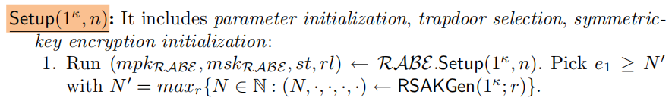
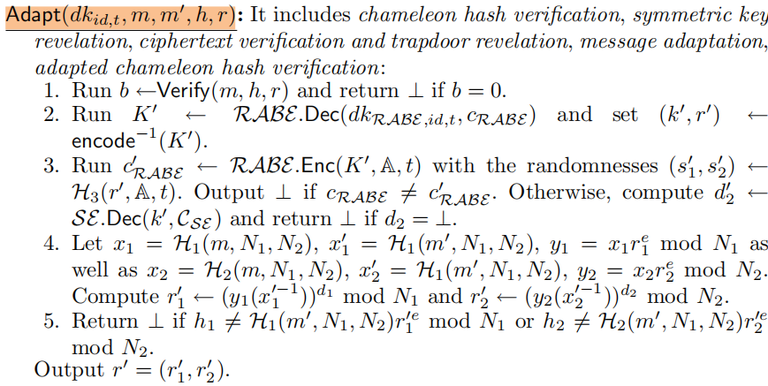
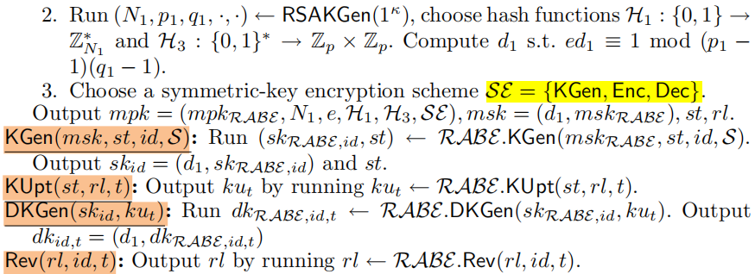
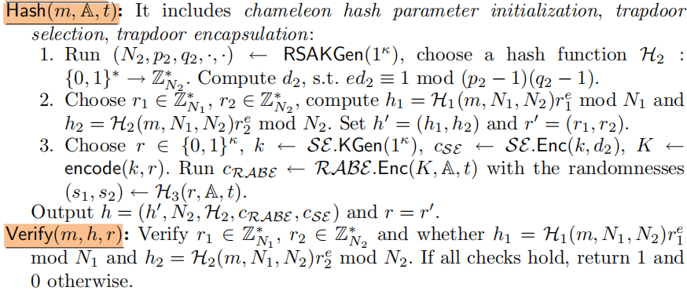
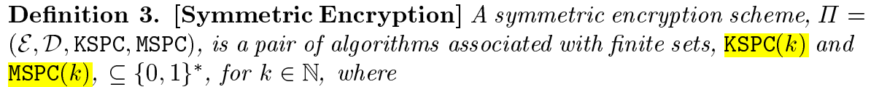
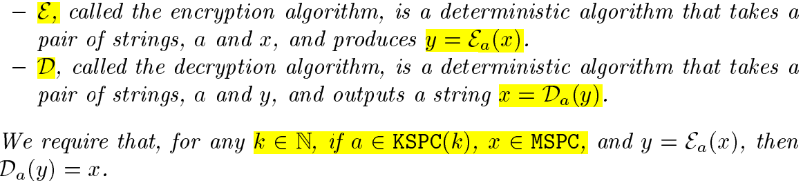
西安邮电大学
XI'AN UNIVERSITY OF POSTS
& TELECOMMUNICATIONS
RPCH
$$a$$

Slide 19
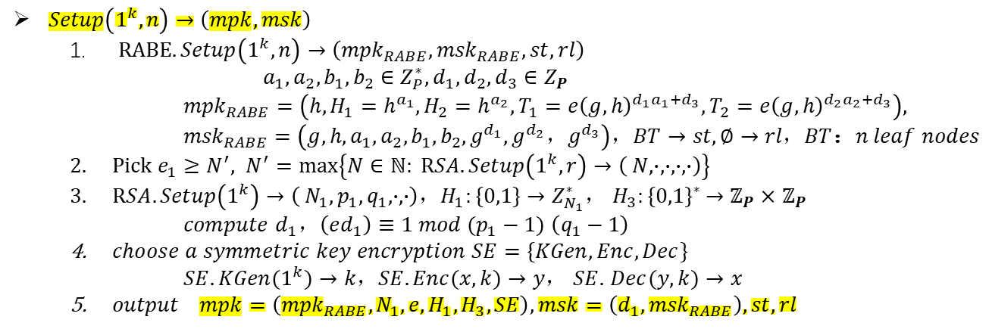
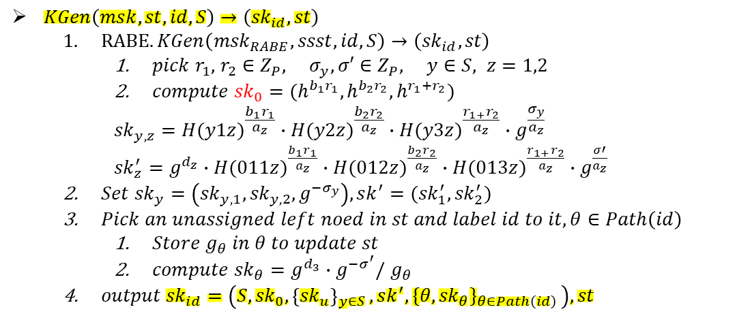
西安邮电大学
XI'AN UNIVERSITY OF POSTS
& TELECOMMUNICATIONS
RPCH
$Setup\left(1^{k},n\right)→\left(mpk,msk\right)$
$RABE.Setup\left(1^{k},n\right)→\left({mpk}_{RABE},{msk}_{RABE},st,rl\right)$
$$a_{1},a_{2},b_{1},b_{2}∈Z_{P}^{∗},d_{1},d_{2},d_{3}∈Z_{P}$$
$${mpk}_{RABE}=\left(h,H_{1}=h^{a_{1}},H_{2}=h^{a_{2}},T_{1}={e\left(g,h\right)}^{{d_{1}a}_{1}+d_{3}},T_{2}={e\left(g,h\right)}^{{d_{2}a}_{2}+d_{3}}\right),$$
${msk}_{RABE}=\left(g,h,a_{1},a_{2},b_{1},b_{2},g^{d_{1}},g^{d_{2}}，g^{d_{3}}\right)，BT→st,∅→rl，BT$：$n leaf nodes$
$Pick e_{1}≥N^{′}, N^{′}=max\left\{N∈ℕ: RSA.Setup\left(1^{k},r\right)→\left( N,∙,∙,∙,∙\right)\right\}$
$RSA.Setup\left(1^{k}\right)→\left( N_{1},p_{1},q_{1},∙,∙\right)，H_{1}:\{0,1\}→Z_{N_{1}}^{∗}$， $H_{3}{:\{0,1\}}^{∗}→ℤ_{P}×$ $ℤ_{P}$
$compute$ $d_{1}，\left(ed_{1}\right)≡1 mod (p_{1}−1)$ $\left(q_{1}−1\right)$
$choose a symmetric key encryption SE=\{KGen,Enc,Dec\}$
$SE.KGen(1^{k})→k，SE.Enc(x,k)→y，$ $SE.$ $Dec(y,k)→x$
$output mpk=\left({mpk}_{RABE},N_{1},e,H_{1},H_{3},SE\right),msk=\left(d_{1},{msk}_{RABE}\right),st,rl$
$KGen\left(msk,st,id,S\right)→\left({sk}_{id},st\right)$
$RABE.KGen\left({msk}_{RABE},ssst,id,S\right)→\left({sk}_{id},st\right)$
$pick r_{1},$ $r_{2}∈$ $Z_{P}, σ_{y},σ′$ $∈$ $Z_{P}, y∈S, z=1,2$
$compute {sk}_{0}=(h^{b_{1}r_{1}},h^{b_{2}r_{2}},h^{r_{1}+r_{2}})$
$${sk}_{y,z}={H(y1z)}^{\frac{b_{1}r_{1}}{a_{z}}}∙{H(y2z)}^{\frac{b_{2}r_{2}}{a_{z}}}∙{H(y3z)}^{\frac{r_{1+}r_{2}}{a_{z}}}∙g^{\frac{σ_{y}}{a_{z}}}$$
${sk}_{z}^{′}=$ $g^{d_{z}}∙{H(011z)}^{\frac{b_{1}r_{1}}{a_{z}}}∙{H(012z)}^{\frac{b_{2}r_{2}}{a_{z}}}∙{H(013z)}^{\frac{r_{1+}r_{2}}{a_{z}}}∙g^{\frac{σ′}{a_{z}}}$
$Set {sk}_{y}=\left({sk}_{y,1},{sk}_{y,2},g^{{−σ}_{y}}\right),sk^{′}=({sk}_{1}^{′},{sk}_{2}^{′})$
$Pick an unassigned left noed in st and label id to it,θ∈Path\left(id\right)$
$Store g_{θ} in θ to update st$
$compute {sk}_{θ}=g^{d_{3}}∙g^{−σ^{′}}/$ $g_{θ}$
$output {sk}_{id}=\left(S,{sk}_{0}{,\left\{{sk}_{u}\right\}}_{y∈S},sk^{′}{,\{θ,{sk}_{θ}\}}_{θ∈Path\left(id\right)}\right),st$

Slide 20
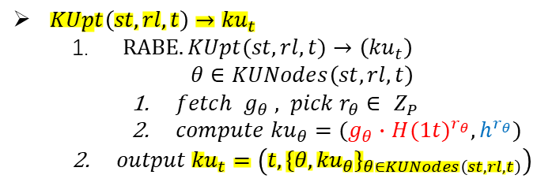
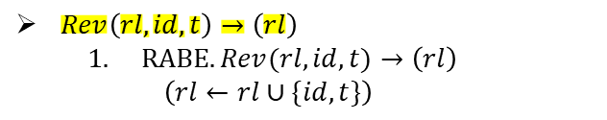
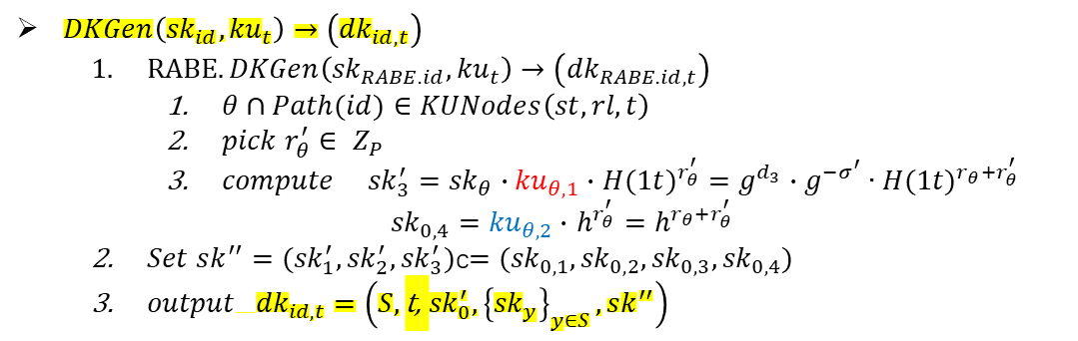
西安邮电大学
XI'AN UNIVERSITY OF POSTS
& TELECOMMUNICATIONS
RPCH
$KUpt\left(st,rl,t\right)→{ku}_{t}$
$RABE.KUpt(st,rl,t)→\left({ku}_{t}\right)$
$$θ∈KUNodes\left(st,rl,t\right)$$
$fetch g_{θ} , pick r_{θ}∈ Z_{P}$
$compute {ku}_{θ}=(g_{θ}∙$ ${H(1t)}^{r_{θ}},h^{r_{θ}})$
$output {ku}_{t}=\left(t, {\{θ,{ku}_{θ}\}}_{θ∈KUNodes\left(st,rl,t\right)}\right)$
$DKGen\left({sk}_{id},{ku}_{t}\right)→\left({dk}_{id,t}\right)$
$RABE.DKGen\left({sk}_{RABE.id},{ku}_{t}\right)→\left({dk}_{RABE.id,t}\right)$
$θ∩Path(id)∈KUNodes\left(st,rl,t\right)$
$pick r_{θ}^{′}∈ Z_{P}$
$compute{ sk}_{3}^{′}=$ ${sk}_{θ}∙{ku}_{θ,1}∙$ ${H(1t)}^{r_{θ}^{′}}=$ $g^{d_{3}}∙g^{−σ^{′}}∙{H(1t)}^{r_{θ}+r_{θ}^{′}}$
${sk}_{0,4}={ku}_{θ,2}∙$ $h^{r_{θ}^{′}}=$ $h^{r_{θ}+r_{θ}^{′}}$
$Set sk^{′′}=({sk}_{1}^{′},{sk}_{2}^{′},{sk}_{3}^{′})$c$=({sk}_{0,1},{sk}_{0,2},{sk}_{0,3},{sk}_{0,4})$
$output{ dk}_{id,t}=\left(S,\text{t}\text{,} {sk}_{0}^{′}{,\left\{{sk}_{y}\right\}}_{y∈S},sk^{′′}\right)$
$Rev\left(rl,id,t\right)→\left(rl\right)$
$RABE.Rev(rl,id,t)→\left(rl\right)$
$$\left(rl←rl∪\{id,t\}\right)$$

Slide 21
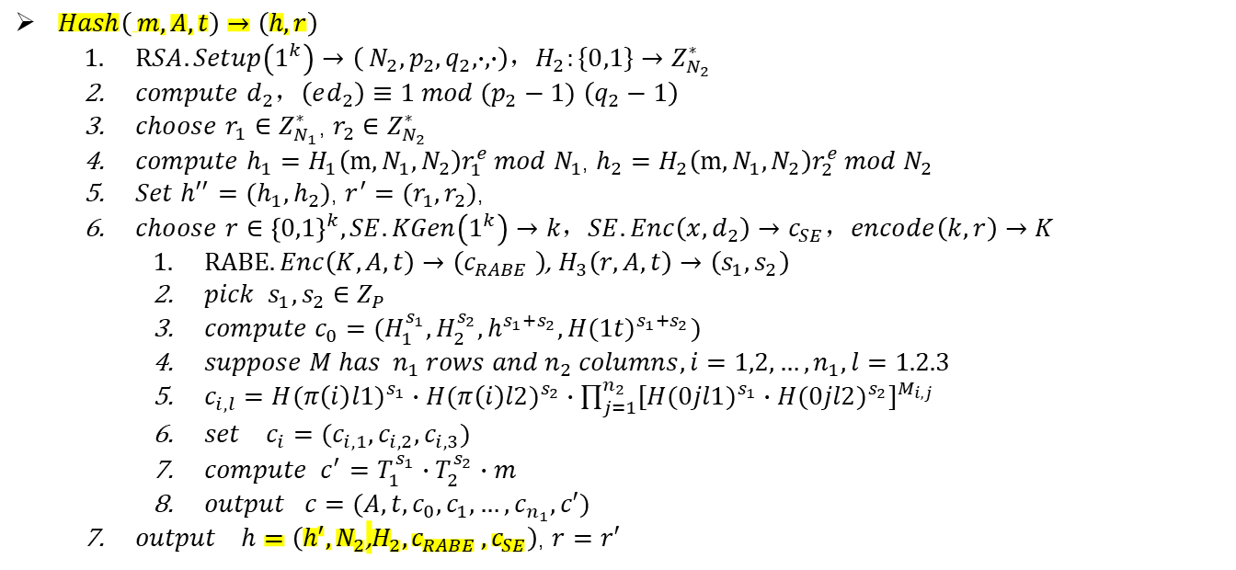
西安邮电大学
XI'AN UNIVERSITY OF POSTS
& TELECOMMUNICATIONS
RPCH
$Hash\left( m,A,t\right)→\left(h,r\right)$
$RSA.Setup\left(1^{k}\right)→\left( N_{2},p_{2},q_{2},∙,∙\right)，H_{2}:\{0,1\}→Z_{N_{2}}^{∗}$
$compute d_{2}，\left(ed_{2}\right)≡1 mod (p_{2}−1) \left(q_{2}−1\right)$
$choose$ $r_{1}∈Z_{N_{1}}^{∗}$, $r_{2}∈Z_{N_{2}}^{∗}$
$compute$ $h_{1}=H_{1}\left(m,N_{1},N_{2}\right)r_{1}^{e} mod N_{1}$, $h_{2}=H_{2}\left(m,N_{1},N_{2}\right)r_{2}^{e} mod N_{2}$
$Set h^{′′}=(h_{1},h_{2})$, $r^{′}=(r_{1},r_{2})$,
$choose$ $r∈{\left\{0,1\right\}}^{k}, SE.KGen\left(1^{k}\right)→k，SE.Enc\left(x,d_{2}\right)→c_{SE}，encode\left(k,r\right)→K$
$RABE. Enc\left(K,A,t\right)→\left(c_{RABE} \right)$, $H_{3}\left(r,A,t\right)→\left(s_{1},s_{2}\right)$
$pick s_{1},s_{2}∈Z_{P}$
$compute$ $c_{0}=(H_{1}^{s_{1}},H_{2}^{s_{2}},h^{s_{1}+s_{2}},{H(1t)}^{s_{1}+s_{2}})$
$suppose M has n_{1} rows and n_{2} columns,i=1,2,…,n_{1},l=1.2.3$
$c_{i,l}={H(π\left(i\right)l1)}^{s_{1}}∙{H(π\left(i\right)l2)}^{s_{2}}∙\prod_{j=1}^{n_{2}}{{[{H(0jl1)}^{s_{1}}∙{H(0jl2)}^{s_{2}}]}^{M_{i,j}}}$
$set c_{i}=(c_{i,1},c_{i,2},c_{i,3})$
$compute c^{′}=T_{1}^{s_{1}}∙T_{2}^{s_{2}}∙m$
$output c=(A,t,c_{0},c_{1},…,c_{n_{1}},c′)$
$output h=\left(h^{′},N_{2}\text{,}H_{2}{,c}_{RABE},c_{SE}\right)$, $r=r′$
$Verify\left( m,h,r\right)→\left(1 or 0\right)$
$Verify r_{1}∈Z_{N_{1}}^{∗}$, $r_{2}∈Z_{N_{2}}^{∗}$
$Verify h_{1}=H_{1}\left(m,N_{1},N_{2}\right)r_{1}^{e} mod N_{1}\text{, }h_{2}=H_{2}\left(m,N_{1},N_{2}\right)r_{2}^{e} mod N_{2}$

Slide 22
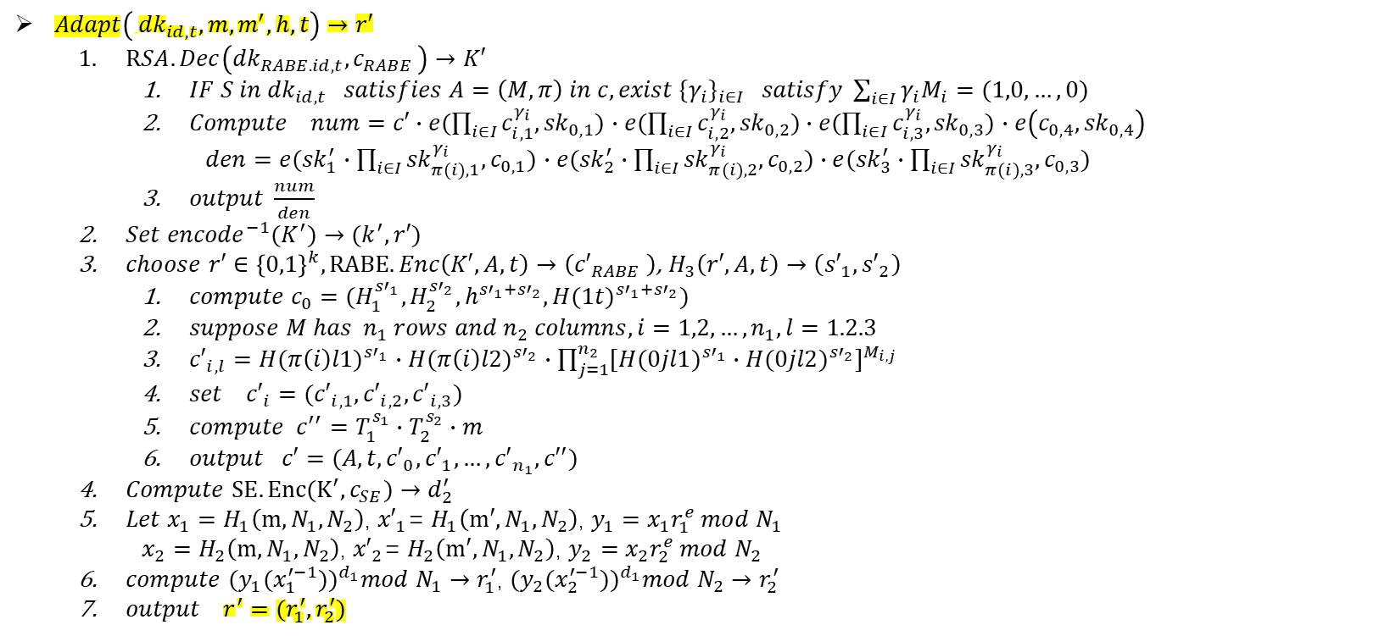
西安邮电大学
XI'AN UNIVERSITY OF POSTS
& TELECOMMUNICATIONS
RPCH
$Adapt\left( {dk}_{id,t},m,m^{′},h,t\right)→r′$
$RSA.Dec\left({dk}_{RABE.id,t}{,c}_{RABE}\right)→K′$
$IF S in {dk}_{id,t} satisfies A=\left(M,π\right) in c,exist {\{γ_{i}\}}_{i∈I} satisfy \sum_{i∈I}{γ_{i}M_{i}=(1,0,…,0)}$
$Compute$ $num=c′∙e(\prod_{i∈I}{c_{i,1}^{γ_{i}},{sk}_{0,1}})$ $∙e(\prod_{i∈I}{c_{i,2}^{γ_{i}},{sk}_{0,2}})∙e(\prod_{i∈I}{c_{i,3}^{γ_{i}},{sk}_{0,3}})$ $∙e\left(c_{0,4},{sk}_{0,4}\right)$
$den=e({sk}_{1}^{′}∙\prod_{i∈I}{{sk}_{π(i),1}^{γ_{i}},c_{0,1}})$ $∙e({sk}_{2}^{′}∙\prod_{i∈I}{{sk}_{π(i),2}^{γ_{i}},c_{0,2}})∙e({sk}_{3}^{′}∙\prod_{i∈I}{{sk}_{π(i),3}^{γ_{i}},c_{0,3}})$
$output \frac{num}{den}$
$Set {{encode}^{−1}(K}^{′})→(k^{′},r′)$
$choose$ $r′∈{\left\{0,1\right\}}^{k}, RABE. Enc\left(K′,A,t\right)→\left({c′}_{RABE} \right)$, $H_{3}\left(r′,A,t\right)→\left({s′}_{1},{s′}_{2}\right)$
$compute$ $c_{0}=(H_{1}^{{s′}_{1}},H_{2}^{{s′}_{2}},h^{{s′}_{1}+{s′}_{2}},{H(1t)}^{{s′}_{1}+{s′}_{2}})$
$suppose M has n_{1} rows and n_{2} columns,i=1,2,…,n_{1},l=1.2.3$
${c′}_{i,l}={H(π\left(i\right)l1)}^{{s′}_{1}}∙{H(π\left(i\right)l2)}^{{s′}_{2}}∙\prod_{j=1}^{n_{2}}{{[{H(0jl1)}^{{s′}_{1}}∙{H(0jl2)}^{{s′}_{2}}]}^{M_{i,j}}}$
$set {c′}_{i}=({c′}_{i,1},{c′}_{i,2},{c′}_{i,3})$
$compute c^{′′}=T_{1}^{s_{1}}∙T_{2}^{s_{2}}∙m$
$output c′=(A,t,{c′}_{0},{c′}_{1},…,{c′}_{n_{1}},c′′)$
$Compute$ $SE.Enc(K^{′},c_{SE}){→d}_{2}^{′}$
$Let x_{1}=$ $H_{1}\left(m,N_{1},N_{2}\right)$, ${x′}_{1}$= $H_{1}\left(m′,N_{1},N_{2}\right)$, $y_{1}=x_{1}r_{1}^{e} mod N_{1}$
$x_{2}=$ $H_{2}\left(m,N_{1},N_{2}\right)$, ${x′}_{2}$= $H_{2}\left(m′,N_{1},N_{2}\right)$, $y_{2}=x_{2}r_{2}^{e} mod N_{2}$
$compute$ ${{(y_{1}(x_{1}^{′−1}))}^{d_{1}}mod{ N}_{1}→r}_{1}^{′}$, ${{(y_{2}(x_{2}^{′−1}))}^{d_{1}}mod{ N}_{2}→r}_{2}^{′}$
$output r^{′}=(r_{1}^{′},r_{2}^{′})$

Slide 23
西安邮电大学
XI'AN UNIVERSITY OF POSTS
& TELECOMMUNICATIONS
RSA
补充材料

Slide 24
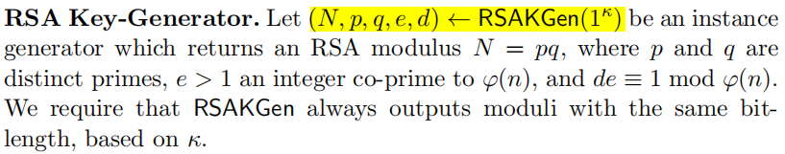
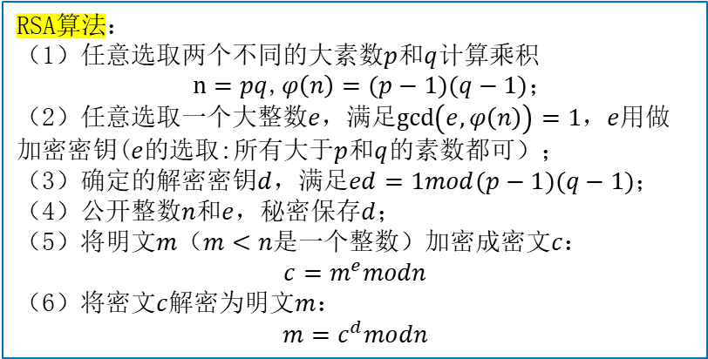
西安邮电大学
XI'AN UNIVERSITY OF POSTS
& TELECOMMUNICATIONS
RSA
RSA算法：
（1）任意选取两个不同的大素数$p$和$q$计算乘积
$n=pq$,$φ\left(n\right)=(p−1)(q−1)$；
（2）任意选取一个大整数$e$，满足$\gcd\left(e,φ\left(n\right)\right)=1$，$e$用做加密密钥($e$的选取:所有大于$p$和$q$的素数都可）；
（3）确定的解密密钥$d$，满足$ed=1mod(p−1)(q−1)$；
（4）公开整数$n$和$e$，秘密保$存d$；
（5）将明文$m$（$m<n$是一个整数）加密成密文$c$：
$$c=m^{e}modn$$
（6）将密文$c$解密为明文$m$：
$$m=c^{d}modn$$

Slide 25
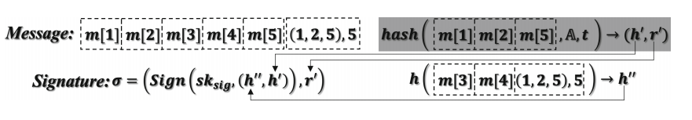
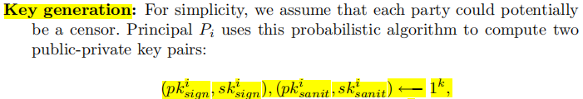
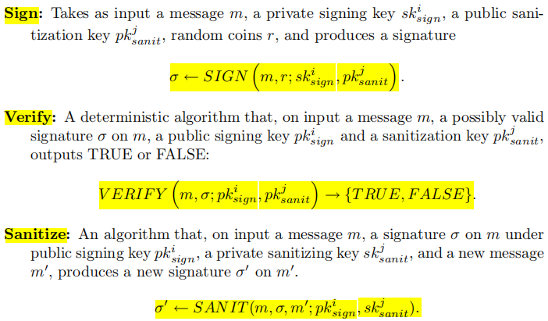


西安邮电大学
XI'AN UNIVERSITY OF POSTS
& TELECOMMUNICATIONS
Sanitizable Signature
$$m^{′}\left[3\right]$$
$hash (m\left[1\right] m\left[2\right] m^{′}\left[3\right],A,t)→(h^{′},r′′′)$
${σ′=Sign(sk}_{sani},\left(h^{′′},h^{′}\right),r′′′)$

Slide 26
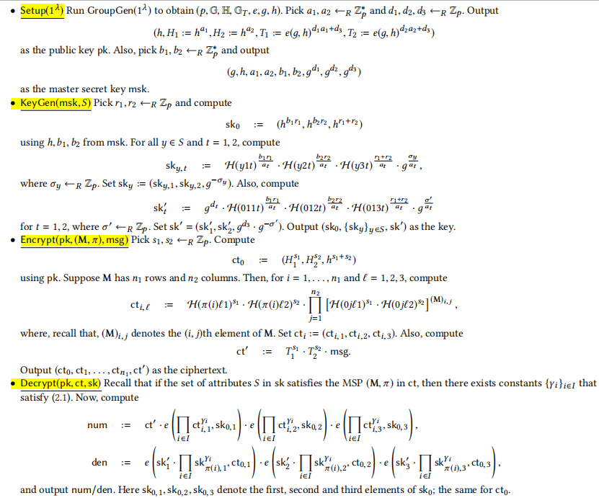
西安邮电大学
XI'AN UNIVERSITY OF POSTS
& TELECOMMUNICATIONS
FAME

